Slide 1
Progress review 1

Slide 2
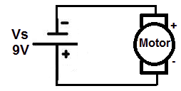
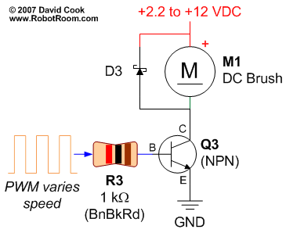
H bridge
Connected to power source DC motor can only in one direction.
However, controlled through transistor and PWM, motor can spin with variable speed..
..but, how to move backwards?
Solution: H-bridge

Slide 3
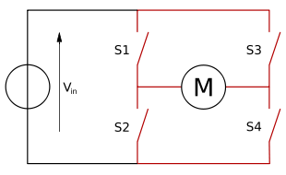
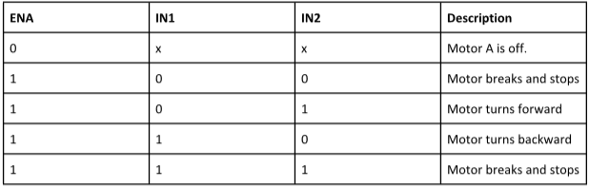
H bridge
Principle of an H bridge.
Replace each switch with a transistor.
S1 and S4 => IN1.
S2 and S3 => IN2.
Truth table:

Slide 4
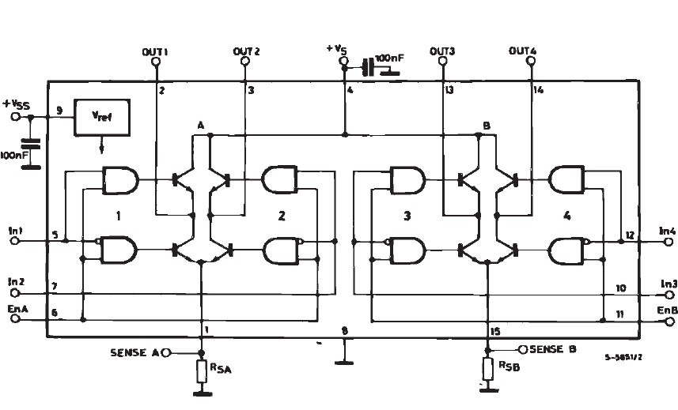
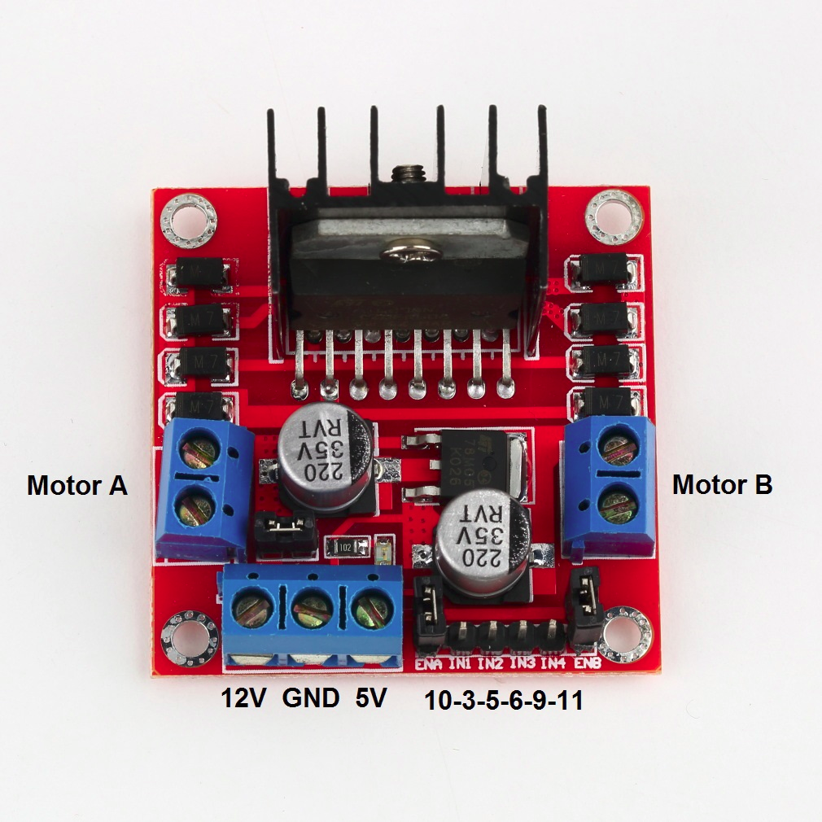
H bridge
In this project, we will use the motor driver l298n (double H bridge for 2 DC motors).

Slide 5
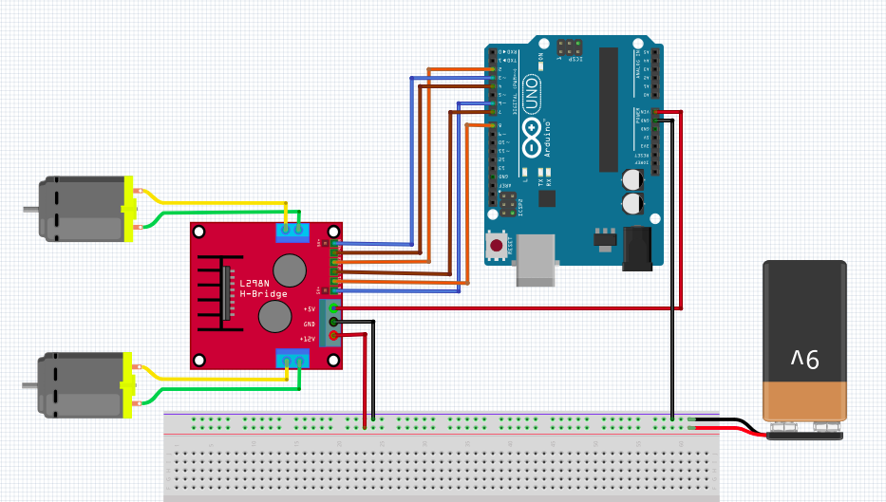
H bridge
Circuit

Slide 6

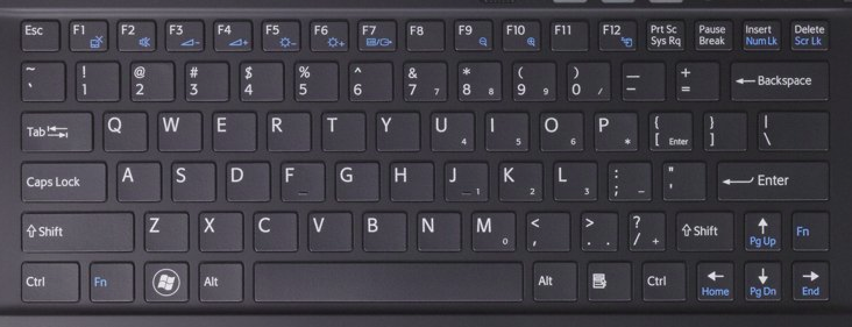
Commands from control station
Use of the keyboard to control the recovery system.
Implementation of a first version.

Slide 7
Commands from control station
Keyboard map.
Winch step up/down: ‚q‘ / ‚a‘.
Turn light on/off: ‚1‘ / ‚2‘.
Turn camera one step right/left: ‚x‘ / ‚z‘.

Slide 8
Commands from control station
Raise/lower upper claw: ‚r‘ / ‚f‘.
Raise/lower lower claw: ‚t‘ / ‚g‘.
Move the car forwards/backwards: ‚i‘ / ‚k‘.
Turn the car to the left/right: ‚j‘ / ‚l‘ (increasing the speed of one motor and decreasing the speed of the other motor).

Slide 9
Commands from control station
3 different drive modes: duty cycle up to 255/255 => ‚b‘, duty cycle up to 190/255 => ‚n‘, duty cycle up to 130/255 ‚c‘.
Spinning the car to the left/right: ‚J‘ / ‚L‘

Slide 10
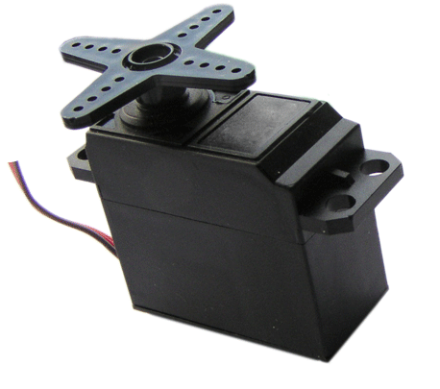
Claw
To Buoy
Camera
Two-part cylindrical claw from a PVC pipe:
Upper part: 3 quarters.
Lower part: 1 quarter.
Opening and closing through two servo motors, one for each part.
First prototype controlled through an Arduino.
Claw
Tracks

